Slide 1
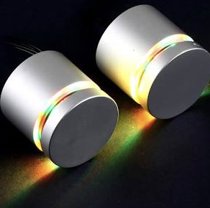
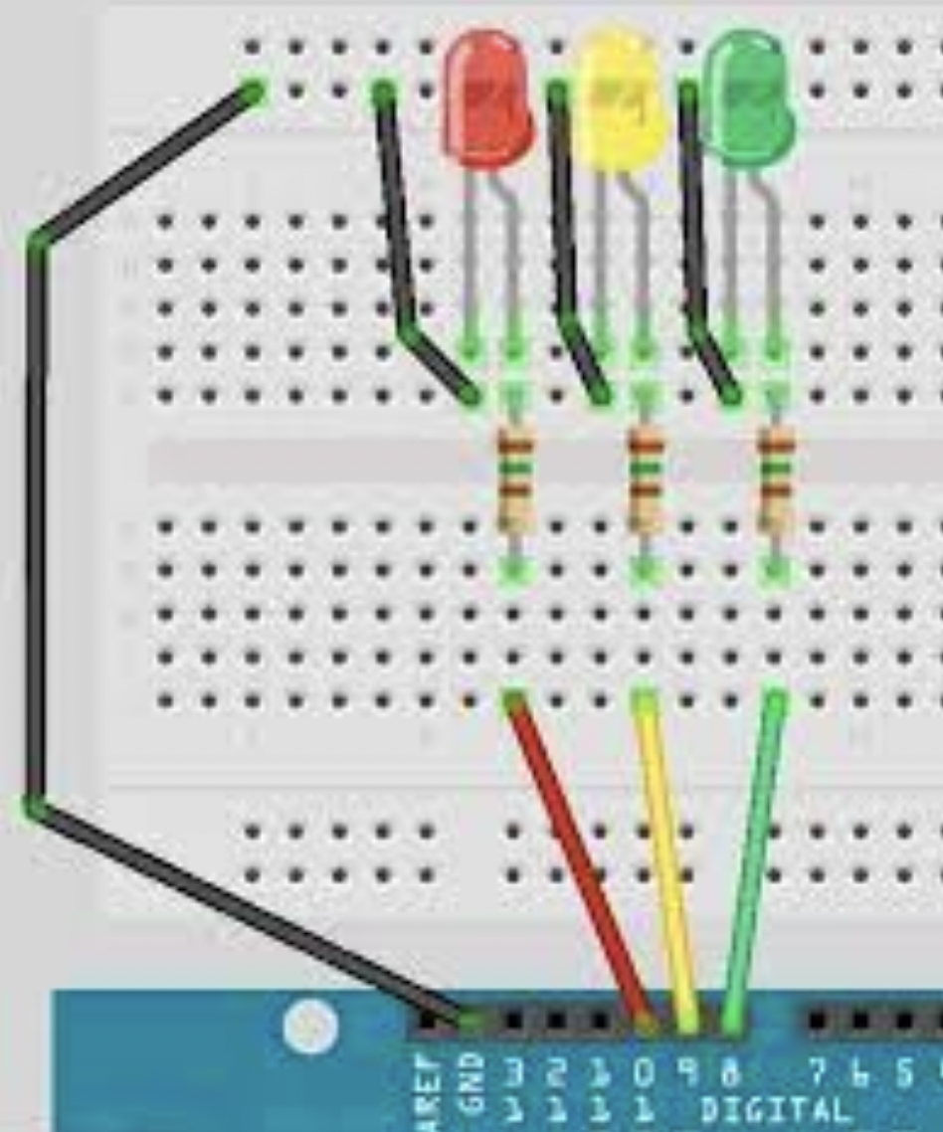
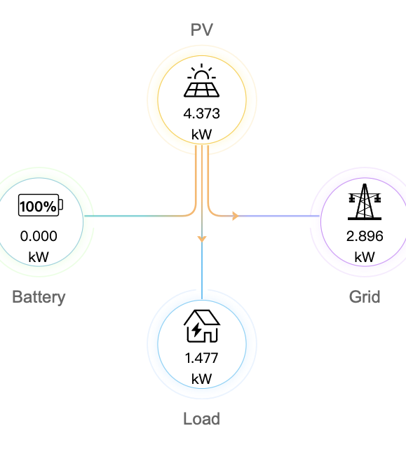
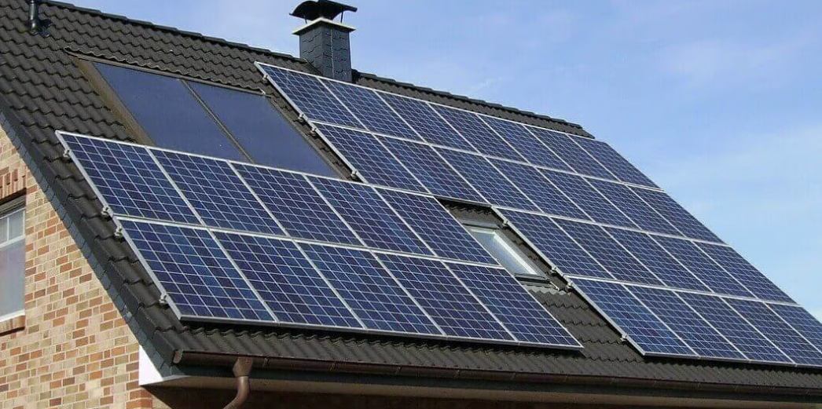
Formative Assessment – Idea: Make it easy to view your solar panel surplus
The main idea is to use solar panels as an input, there is an app/website that records how much energy is produced, used and the surplus. I’m able to extract the values from the website using an API service, from there, depending on the reading from the PV to the grid (which will be indicating the surplus of energy) the output will be three lightbulbs and different ones light up depending on the value, no light means no surplus, yellow light means slight surplus and green light means big surplus.
I will be making a simpler version using the lightbulbs available but in the hypothetical case of the real world this would be a small device people can buy if they have solar panels and you could have one in the kitchen, one next to the laundry or next to things that consume large amounts of energy to make the most out of the energy produced by the solar panels also making it easier to understand as people may get confused with values on the website.
Even though it may not seem so artistic I feel like a big part of getting a more sustainable planet is using creativity to make things more efficient and making things like solar panels more accessible. The lights could even be powered by the solar panel itself in the hypothetical case this was a real product.

